Slide 1



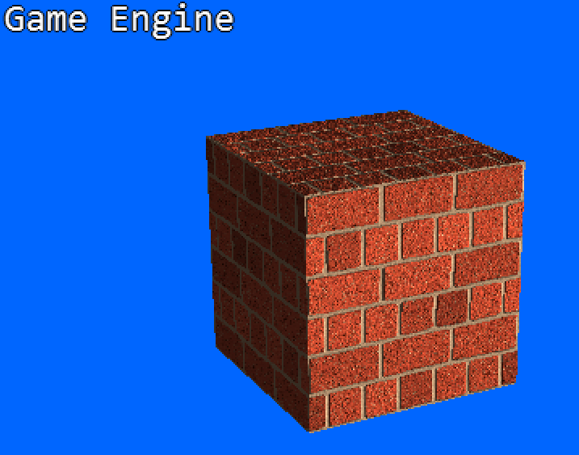

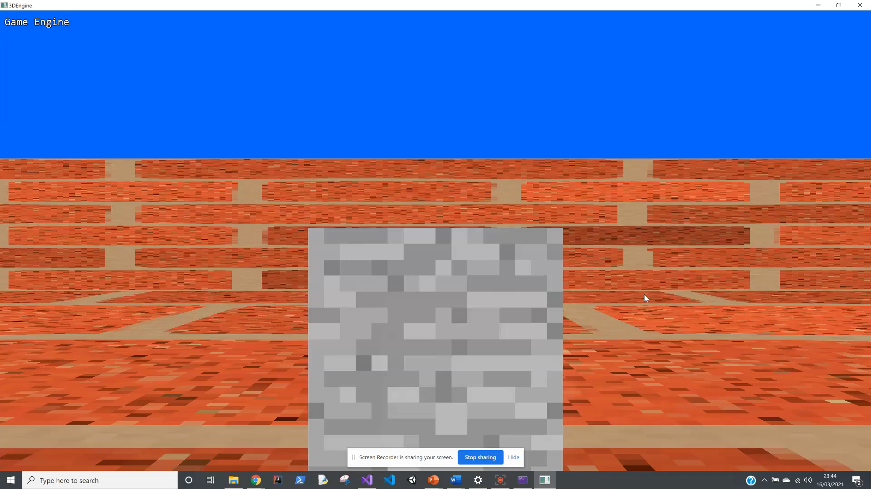
Create a 3D Graphics Engine
Name: Billy Strange Supervisor: Dr Michael Kampouridis
Features
•A functioning 3D graphics engine that a user can use to create an application/game
•Ability to add several objects with the ability to add textures to each object
•Player collision with all objects and able to toggle this on or off
•A first-person camera view with the ability to change the starting position and direction
•Able to change the background colour of the 3D world
•Directional lighting and able to change the direction of the light
Explanation
This project's objective is to create a 3D Graphics engine from scratch without the use of an available advanced graphics engine
The aim is to implement as many features as possible whilst also making it simple to use for someone that would like to create a game or application
To do this most of the operations are hidden from the user so they only must write a few lines of code to produce something
Implementation
This project was coded in C# using Visual Studio as the platform
This project also uses OpenGL to draw the graphics
There will also be a wiki available for new users to use to understand how to use the graphics engine
<- This clip shows a created world with player collision in place

